Slide 1
HemTools Tutorial

Slide 2
Outline
Software overview
General principles
Examples
ATAC-seq
ChIP-seq
CUT & RUN
CRISPR-seq

Slide 3
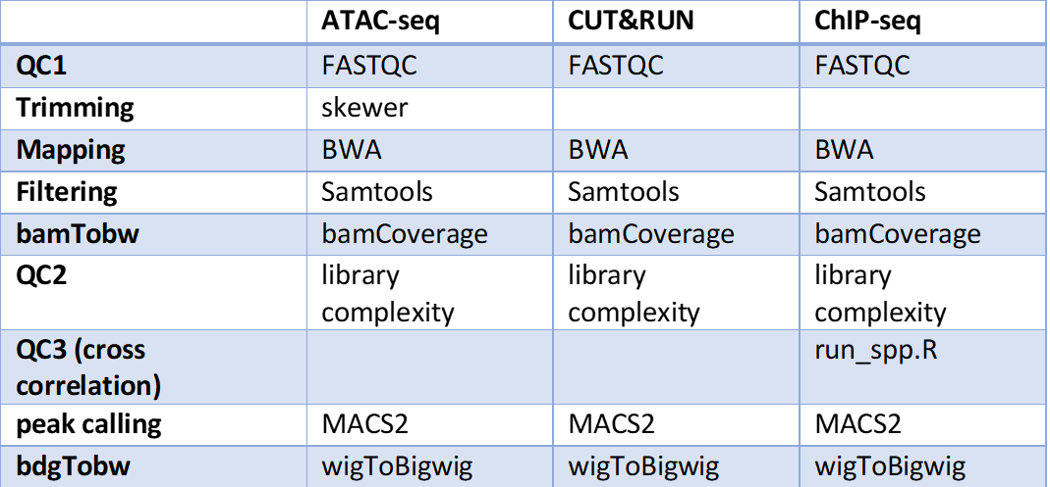
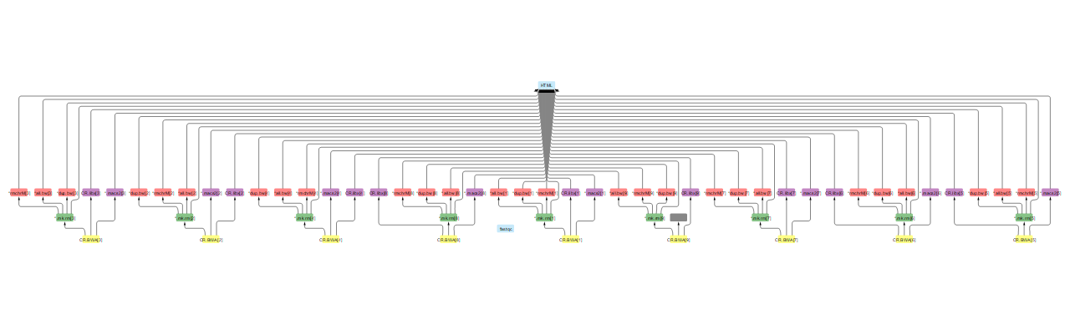
Software overview
Minimizing computation time
A tree of jobs

Slide 4
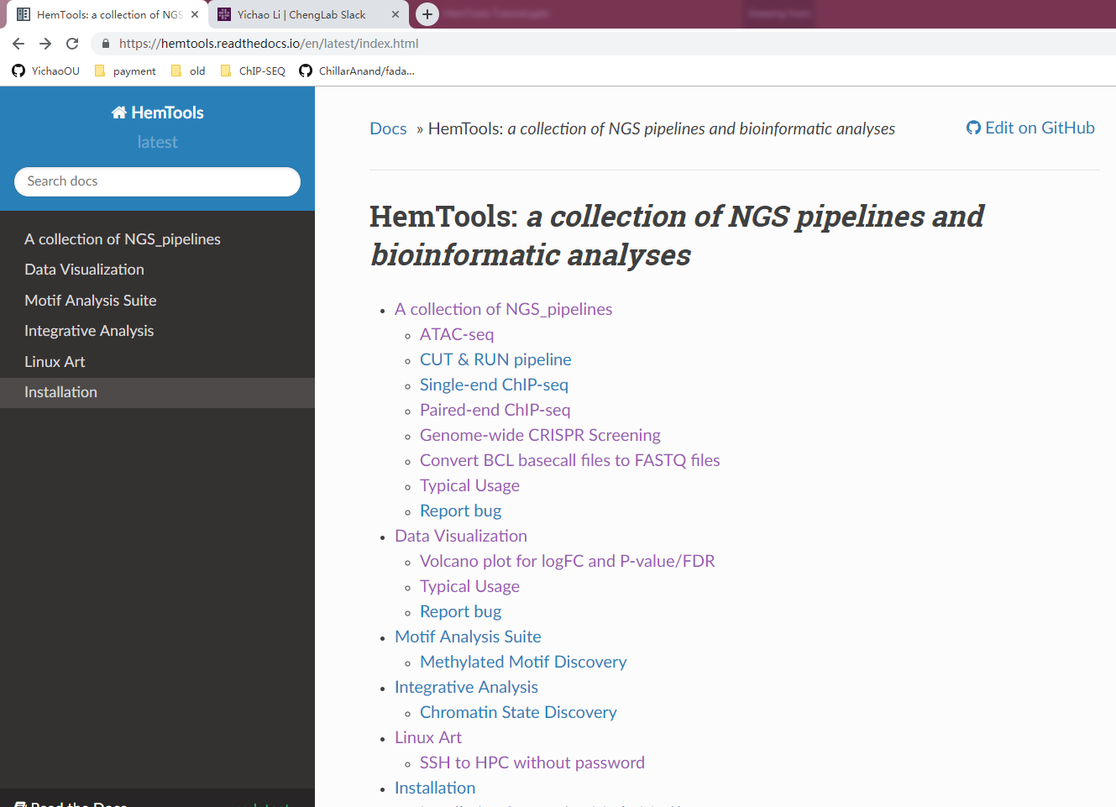
Software overview
Minimizing computation time
A tree of sub-jobs
Creating user-friendly interface
Online documentation
https://hemtools.readthedocs.io
Email notification system
Bug/Error notification system
Visually-appealing reports

Slide 5
Software overview
Minimizing computation time
A tree of sub-jobs
Creating user-friendly interface
Online documentation
https://hemtools.readthedocs.io
Email notification system
Bug/Error notification system
Visually-appealing reports
Reducing user’s mental effort
Free of installation
Simple input files preparation

Slide 6
General principles
Command format
HemTools subcmd some_required_parameters
HemTools atac_seq -f fastq.tsv
HemTools cut_run -f fastq.tsv -d peakcall.tsv
HemTools chip_seq_single -f fastq.tsv -d peakcall.tsv
HemTools chip_seq_pair -f fastq.tsv -d peakcall.tsv
Subcmd is case-insensitive

Slide 7
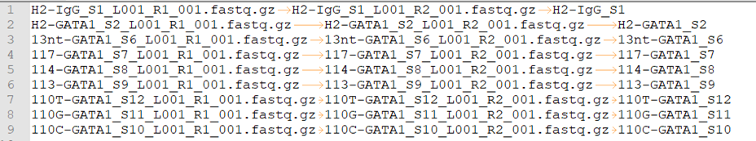
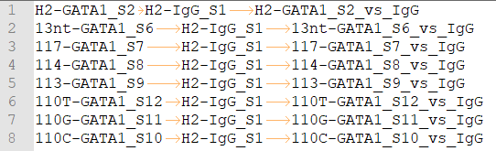
General principles
Command format
HemTools atac_seq -f fastq.tsv
HemTools cut_run -f fastq.tsv -d peakcall.tsv
HemTools chip_seq_single -f fastq.tsv -d peakcall.tsv
HemTools chip_seq_pair -f fastq.tsv -d peakcall.tsv
Input format (tsv, tab-separated values)
-f, --input
-d, --design_matrix

Slide 8
General principles
Output format

Slide 9
General principles
Report bugs

Slide 10
Materials
Handouts
Questionnaire
Online doc
Terminal
Ppt

Slide 11
Software requirements analysis
Adapting and automating previous pipelines
Minimizing computation time
Creating user-friendly interface
Online end-user documentation
Email notification system
Bug/Error notification system
Visually-appealing reports
Reducing user’s mental effort
Free of installation & ready to use
Simple input files preparation
Easy search for appropriate APIs

Slide 12
Linux 101

Slide 14
CUT & RUN example

